Slide 1
Use Cases Diagram

Slide 2
We Will Cover
Use-Case Diagrams
  The constructs in the use-case diagrams
Use Case Diagram Notations
  Use-case ,Use case Actor, Use case relationship
Example of Use case Diagram

Slide 3
What is a Use-Case Diagram
In the Unified Modeling Language (UML), a use case diagram can summarize the details of your system's users (also known as actors) and their interactions with the system. To build one, you'll use a set of specialized symbols and connectors

Slide 4
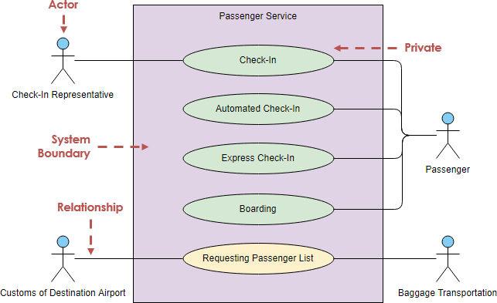
Use Case Diagram Notations

Slide 5
Use-Case
A use-case captures some user visible function
This may be a large or small function
  Depends on the level of detail in your modeling effort
A use-case achieves a discrete goal for the user
Examples
  Format a document
  Request an elevator
How are the use cases found (captured or elicited)?

Slide 6
Use Case
Labelled using a descriptive verb-noun phrase
Represented by an oval
Make
Appointment
Make
Appointment
Notes:
Use case: A use case in a use case diagram is a visual representation of a distinct business functionality in a system. The key term here is "distinct business functionality." To choose a business process as a likely candidate for modeling as a use case, you need to ensure that the business process is discrete in nature. As the first step in identifying use cases, you should list the discrete business functions in your problem statement. Each of these business functions can be classified as a potential use case. Remember that identifying use cases is a discovery rather than a creation. As business functionality becomes clearer, the underlying use cases become more easily evident. A use case is shown as an ellipse in a use case diagram Depicted by an oval
MUST label the oval with the name of the use case

Slide 7
Use Case - Actor
An Actor is outside or external the system.
It can be a:
  Human
  Peripheral device (hardware)
  External system or subsystem
  Time or time-based event
Represented by stick figure
Notes:
Actors
Are NOT a part of the system (external to the system)
A single actor may represent multiple physical users
Whether human or not, represented by stick figure
MUST label stick figure with the name of the actor

Slide 8

Use Case - Actor
Labelled using a descriptive noun or phrase
Represented by a stick character
Notes:
Actors: An actor portrays any entity (or entities) that performs certain roles in a given system. The different roles the actor represents are the actual business roles of users in a given system. An actor in a use case diagram interacts with a use case. For example, for modeling a banking application, a customer entity represents an actor in the application. Similarly, the person who provides service at the counter is also an actor. But it is up to you to consider what actors make an impact on the functionality that you want to model. If an entity does not affect a certain piece of functionality that you are modeling, it makes no sense to represent it as an actor. An actor is shown as a stick figure in a use case diagram depicted "outside" the system boundary, as shown in Make Appointment figure.
Depicted by an oval
MUST label the oval with the name of the use case
To identify an actor, search in the problem statement for business terms that portray roles in the system. For example, in the statement "patients visit the doctor in the clinic for medical tests," "doctor" and "patients" are the business roles and can be easily identified as actors in the system.

Slide 9
Use Case - Relationships
Relationships
  Represent communication between actor and use case
  Depicted by line
  Also called association relationship
association
Make
Appointment
Make
Appointment
Notes:
Use Case Relationship
Association relationship
May exist between actor and a use case
Often referred to as a communicate association
Navigable in both directions (actor to use case and use case to actor)
Some use just a line
Navigable in only one direction (actor to use case OR use case to actor)
Use a arrowhead where arrowhead denotes the direction of communication
Navigation direction of an association represents who is initiating the communication
Multiplicity
Not consistency shown on all use-case diagrams (Some do; some don’t)

Slide 10

Use Case - Relationships
The picture below is a Make Appointment use case for the medical clinic.
The actor is a Patient. The connection between actor and use case is a communication association (or communication for short).
Actors are stick figures. Use cases are ovals. Communications are lines that link actors to use cases.

Slide 11
Use Case - Boundary
Boundary
  A boundary rectangle is placed around the perimeter of the system to show how the actors communicate with the system.
Make
Appointment
Notes:
System boundary: A system boundary defines the scope of what a system will be. A system cannot have infinite functionality. So, it follows that use cases also need to have definitive limits defined. A system boundary of a use case diagram defines the limits of the system. The system boundary is shown as a rectangle spanning all the use cases in the system.
Other use cases in this lecture also show the system boundary of the clinic application. The use cases of this system are enclosed in a rectangle. Note that the actors in the system are outside the system boundary.
The system boundary is potentially the entire system as defined in the problem statement. But this is not always the case. For large and complex systems, each of the modules may be the system boundary. For example, for an ERP system for an organization, each of the modules such as personnel, payroll, accounting, and so forth, can form the system boundary for use cases specific to each of these business functions. The entire system can span all of these modules depicting the overall system boundary.

Slide 12
Use Case Diagram-Relations
Other Types of Relationships for Use Cases
  Generalization
  Include
  Extend
Notes:
Inheritance

Slide 13
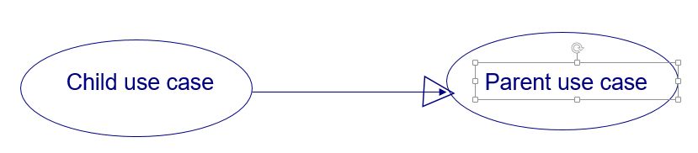
Use Case Diagram-Relations
Generalization Relationship
  Represented by a line and a hollow arrow
    From child to parent
Parent use case
Notes:
Inheritance
A use case generalization shows that one use case is simply a special kind of another.
A clinic may have a use case such as Pay Bill which would be a parent use case and Bill Insurance which is the child.
A child can be substituted for its parent whenever necessary.
Generalization appears as a line with a triangular arrow head toward the parent use case.
Or another case is Make Payment (2 choices): Either by saving account / checking account

Slide 14
Includes and Extends
Includes
  You have a piece of behavior that is similar across many use cases
  Break this out as a separate use-case and let the other ones “include” it
  Examples include
    Validate user interaction
    Sanity check on sensor inputs
    Check for proper authorization
Extends
  A use-case is similar to another one but does a little bit more
  Put the normal behavior in one use-case and the exceptional behavior somewhere else
    Capture the normal behavior
    Try to figure out what can go wrong in each step
    Capture the exceptional cases in separate use-cases
  Makes it a lot easier to understand

Slide 15

Includes
You have a piece of behavior that is similar across many use cases
Break this out as a separate use-case and let the other ones “include” it
Examples include
  Valuation
  Validate user interaction
  Sanity check on sensor inputs
  Check for proper authorization

Slide 16

Extends
A use-case is similar to another one but does a little bit more
Put the normal behavior in one use-case and the exceptional behavior somewhere else
  Capture the normal behavior
  Try to figure out what can go wrong in each step
  Capture the exceptional cases in separate use-cases
Makes it a lot easier to understand

Slide 17
Creating Use Case Diagram
1. Identify Use Cases
2. Draw the system boundary
3. Place Use Cases on the diagram
Group Use Cases into packages
Add special Use Case associations
4. Identify the actors
5. Add associations

Slide 18
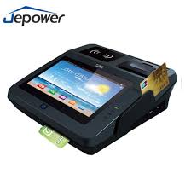
Example (POST)
POST: Point of Sale Terminal
A point of sale terminal (POS terminal) is an electronic device used to process card payments at retail locations. A POS terminal generally does the following: Reads the information off a customer's credit or debit card. Checks whether the funds in a customer's bank account are sufficient.
Adapted from Larman “Applying UML and Patterns”

Slide 19
Example (POST)
POST: Point of Sale Terminal
Use Case
POST
System Boundary
Buy Item
Log In
Cashier
Customer
Refund a Purchased Item
Adapted from Larman “Applying UML and Patterns”

Slide 20
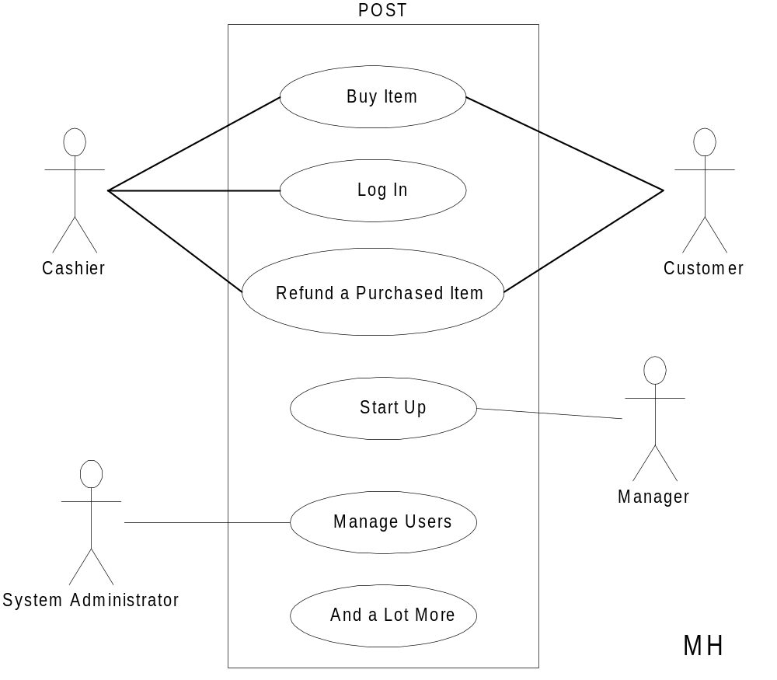
Partial POST
Adapted from Larman “Applying UML and Patterns”
05-Use-Cases

Slide 21
POST Use-Case
Use case: Buy Item
Actors: Customer (initiator), Cashier
Type: Primary
Description: The Customer arrives at the
checkout with items to purchase.
The Cashier records the purchase
items and collects a payment.
On completion the Customer
leaves with the items
05-Use-Cases

Slide 22
POST Expanded Use-Case
Use case: Buy Item
Actors: Customer (initiator), Cashier
Type: Primary and essential
Description: The Customer arrives at the checkout with items
to purchase. The Cashier records the purchase
items and collects a payment. On completion the
Customer leaves with the items.
Cross Ref.: Requirements XX, YY, and ZZ
Use-Cases: Cashier must have completed the Log In use-case

Slide 23
When to use Use-Cases
In short, always!!!
Requirements is the toughest part of software development
  Use-Cases is a powerful tool to understand
    Who your users are (including interacting systems)
    What functions the system shall provide
    How these functions work at a high level
Spend adequate time on requirements and in the elaboration phase

Slide 24
Benefits of Use Cases
Use cases are the primary vehicle for requirements capture in RUP
Use cases are described using the language of the customer (language of the domain which is defined in the glossary)
Use cases provide a contractual delivery process (RUP is Use Case Driven)
Use cases provide an easily-understood communication mechanism
When requirements are traced, they make it difficult for requirements to fall through the cracks
Use cases provide a concise summary of what the system should do at an abstract (low modification cost) level.

Slide 25
Difficulties with Use Cases
As functional decompositions, it is often difficult to make the transition from functional description to object description to class design
Reuse at the class level can be hindered by each developer “taking a Use Case and running with it”. Since UCs do not talk about classes, developers often wind up in a vacuum during object analysis, and can often wind up doing things their own way, making reuse difficult
Use Cases make stating non-functional requirements difficult (where do you say that X must execute at Y/sec?)
Testing functionality is straightforward, but unit testing the particular implementations and non-functional requirements is not obvious

Slide 26
References
https://www.youtube.com/watch?v=zid-MVo7M-E
05-Use-Cases

